Slide 1

Microsoft Movie Studio
Robert Mbau
12th March 2023

Slide 2
Summary
Analysis of data in the movie industry to help Microsoft make a decision on opening a movie studio. The findings support opening of a studio.

Slide 3
Outline
Business Problem
Objectives
Data
Methods
Results
Conclusions
Recommendations

Slide 4
Business Problem
Microsoft want to create a new movies studio.
They don’t have any knowledge about the industry.
They need to understand the market to help make a decision on the movie studio.
Project will help them in making a decision.

Slide 5
Objectives
Identify top rated genres.
Identify market trends.
Give recommendations to Microsoft.

Slide 6
Data
3 data files used.
3 Numeric features and 6 categorical features.
Timeframe of data: 1915 to 2022

Slide 7
Methods
Data preparation: Dataframe creation
Data cleaning
Data analysis
Data visualization

Slide 8
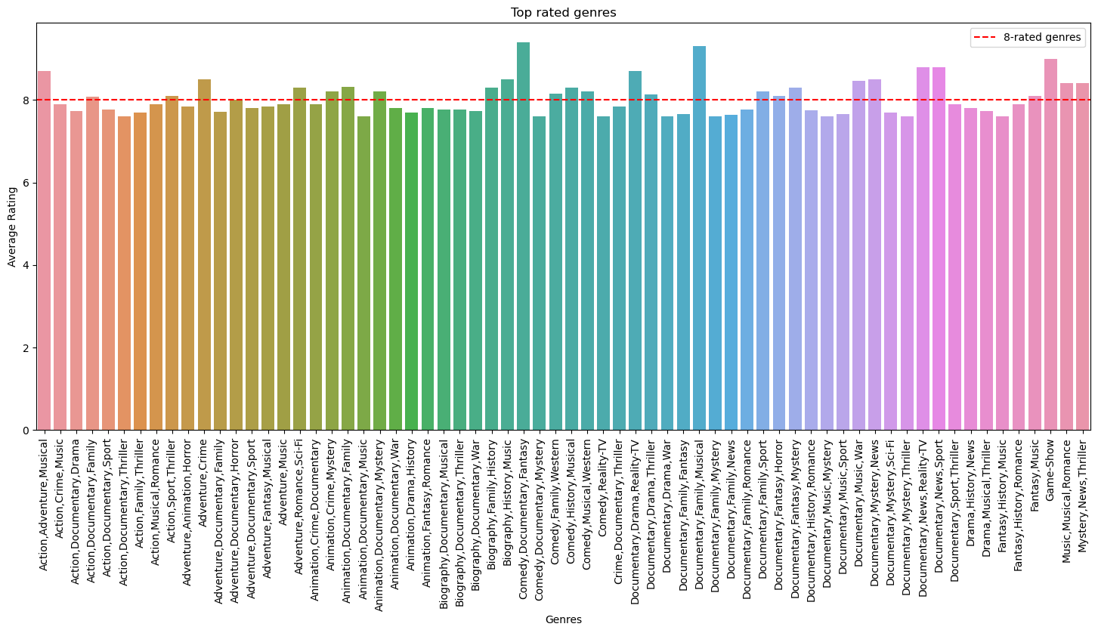
Top rated genres
Identified the highest rated genres.

Slide 9
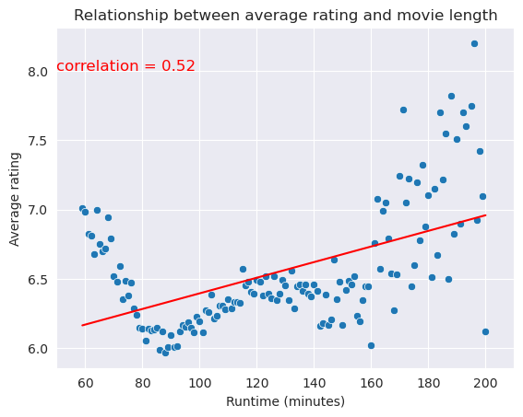
Rating of movies with various length
Analysed the ratings of movies based on their length.
Movie length has a small effect on the rating.

Slide 10
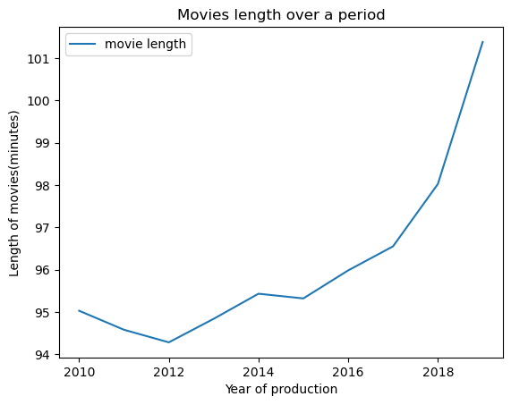
Movie length
Analysed the trend of movie length over a few years.
The length seems to increase over the years.

Slide 11
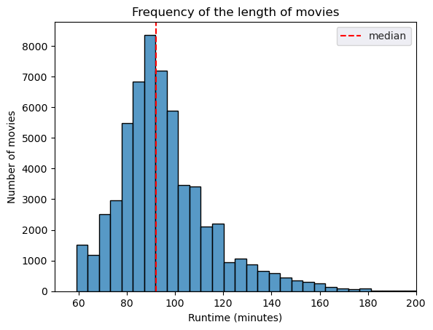
Movie length popularity
Looked at movie lengths and which is the most common.
Movies between 80 minutes to 110 minutes seem most common.

Slide 12
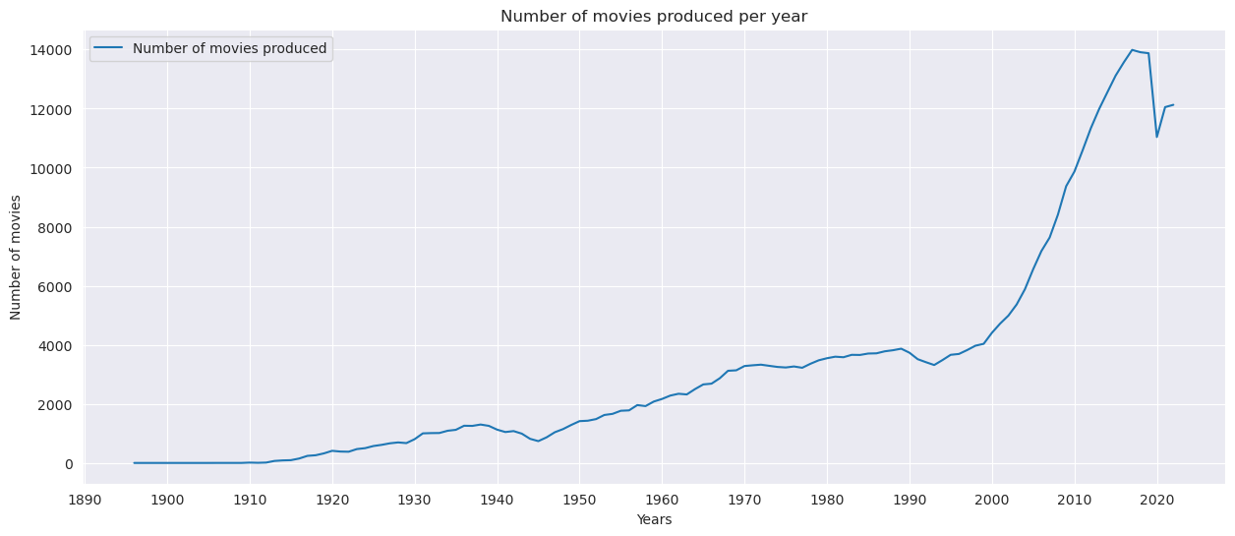
Number of movies produced every year
Analysed the number of movies released per year since 1910.
The number increases steadily.
The drop in numbers between 2020 and 2022 can be attributed partly to studio shutdowns because of Covid-19.

Slide 13
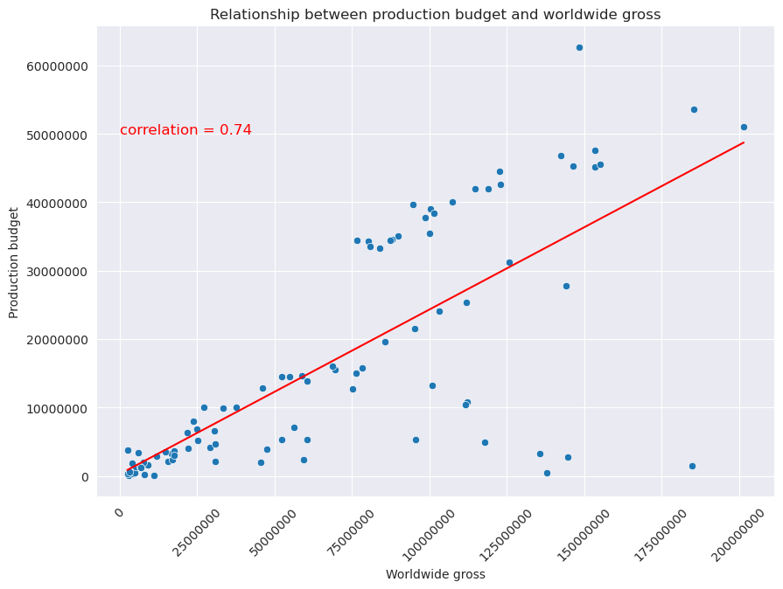
Production budget influence on movie gross
Analysed the production budgets.
The budget affects the movie gross as it is evident when it increases the gross increases.

Slide 14
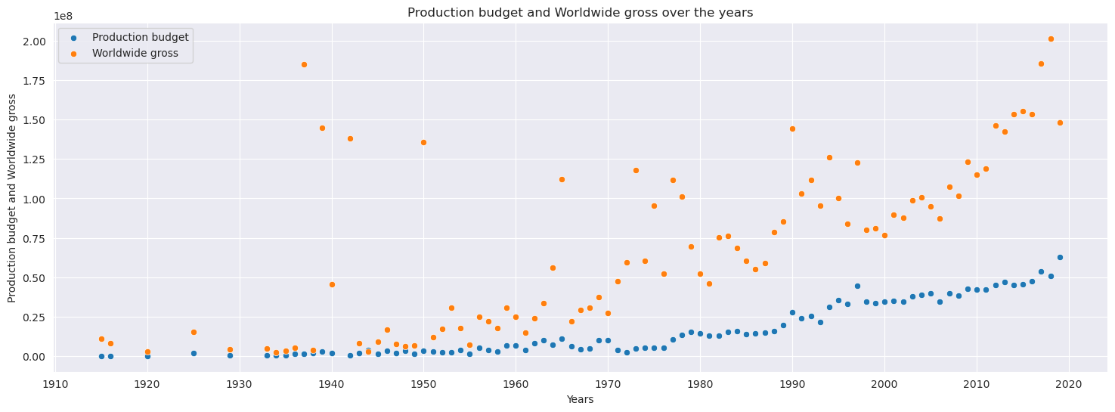
Time effect on production budget and movie gross
Analysed how time has affected production budget and movie gross.
Both have increased although it is not 100% due to time.
Other factors such as population growth can affect movie gross

Slide 15
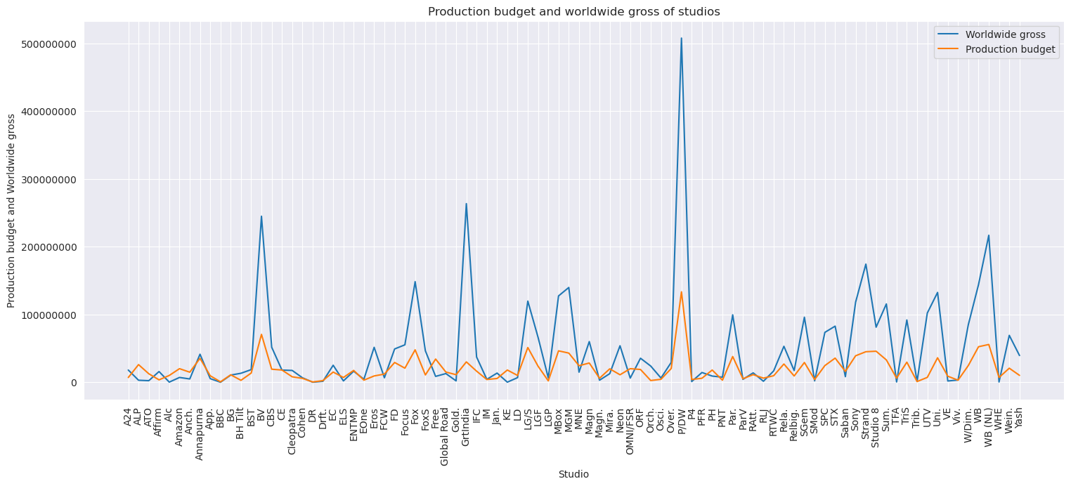
Studio budget effect on movie gross
Analysed various studio budgets and how they affected movies gross.
Studio budget plays a role on the movie gross.
Studios with high budgets have a higher movie gross.

Slide 16
Conclusions
A movie studio is a good business to venture into.
More data can explored to understand what role directors and actors play in movie success.

Slide 17
Recommendations
Invest in the studio: This will include sophisticated equipments, personnel, space and many other factors. A well invested studio will help in producing good movies which will affect the grossing. Don’t cut costs or corners in the name of saving money.
Focus on quality over quantity: As much as you want to produce many movies, don’t sacrifice quality. Audiences are very particular about what they like and a quality movie will have a top grossing.
International market inclusivity: Include the international market in the movies production. Consider distributing movies worldwide and translate them to various languages. Try to make movies culturally relevant to international audiences..

Slide 18
If you have any questions, I’d be happy to answer them.
Thank You!
Email: Robert Mbau
GitHub: Robert Mbau
LinkedIn: Robert Mbau

